Slide 1
How to create your Assistments Account
We are going to begin using a new online quiz system, to replace the previous Achievement Checks.
The system is called Assistments, and you will be receiving small homework assignments where you will be asked to solve questions and enter your solutions online.
I will be using the information about how you’re doing to figure out what types of things you’re having trouble with, so I know what to review in class.
Your first step is to create an account and answer the first set of questions. This needs to be done by Thursday April 4th.
The following slides walk you through what needs to be done. Please follow the instructions, so you can start using Assistments.

Slide 2
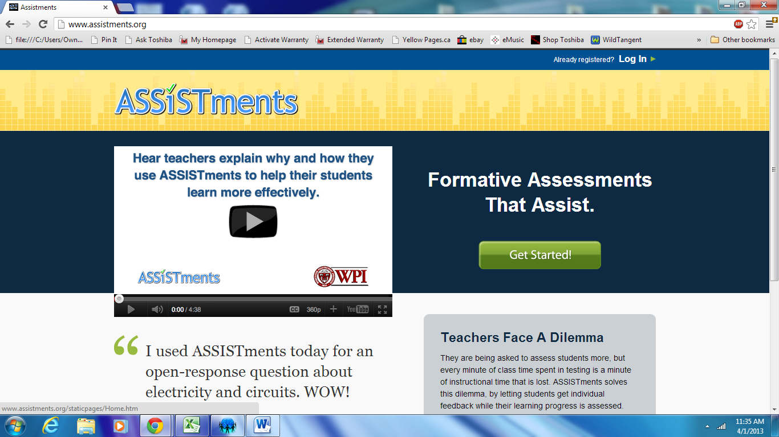
1. Go to www.assistments.org
2. Click Get Started

Slide 3
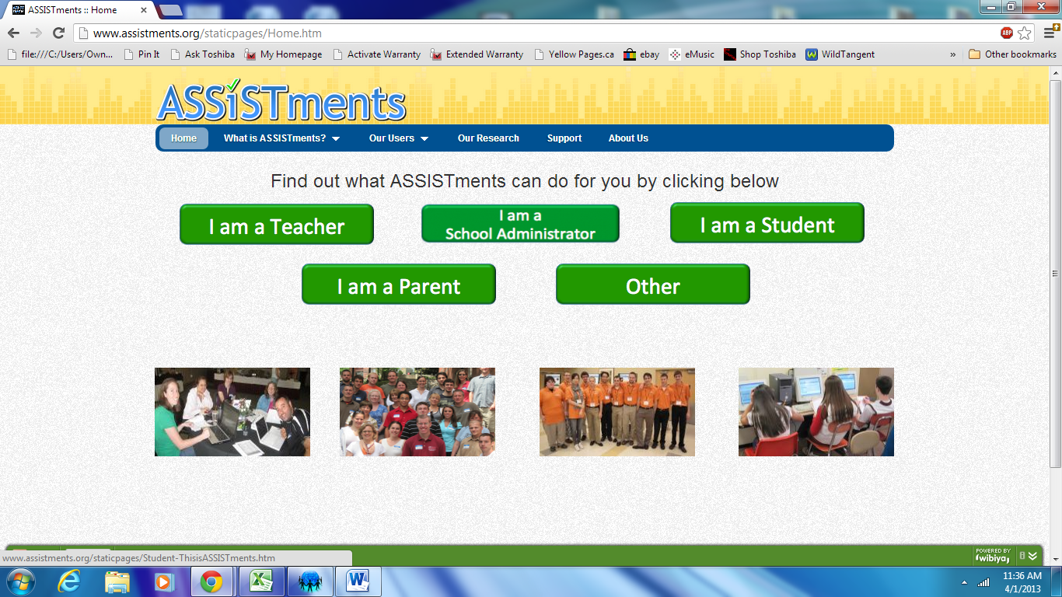
1. Select I am a Student

Slide 4
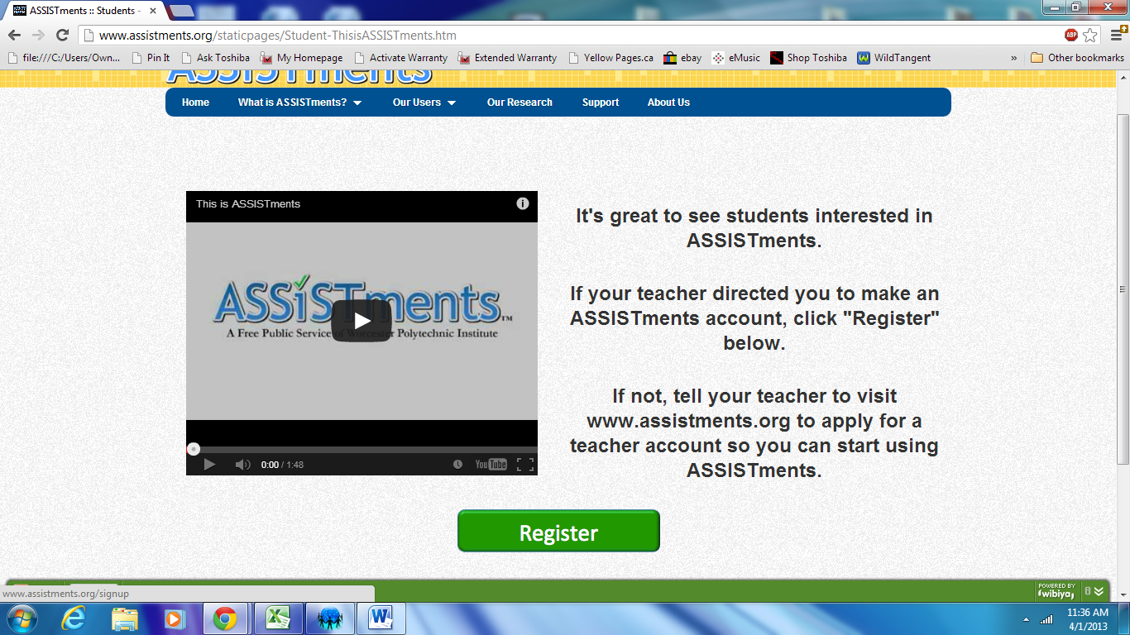
1. Select Register

Slide 5
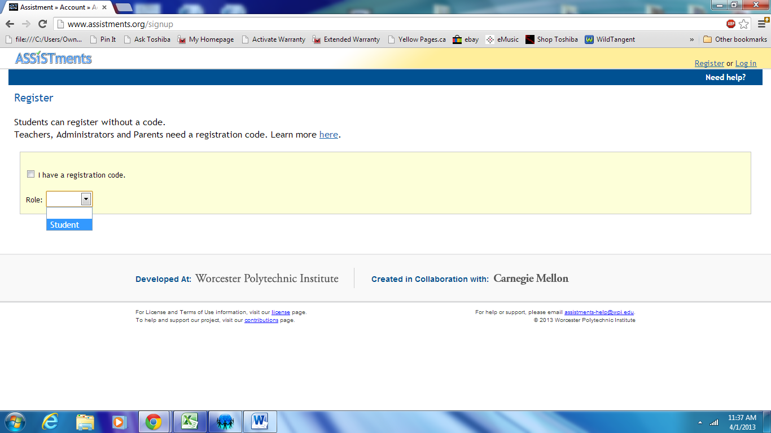
1. Click Role and select Student

Slide 6
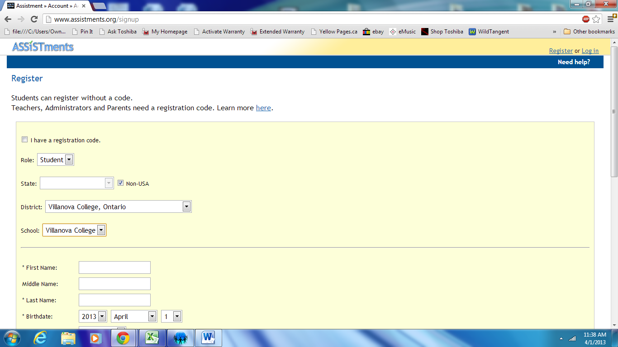
1. Where it says State, check the box marked Non-USA
2. Where it says District, select Villanova College, Ontario
3. Where it says School, select Villanova College

Slide 7
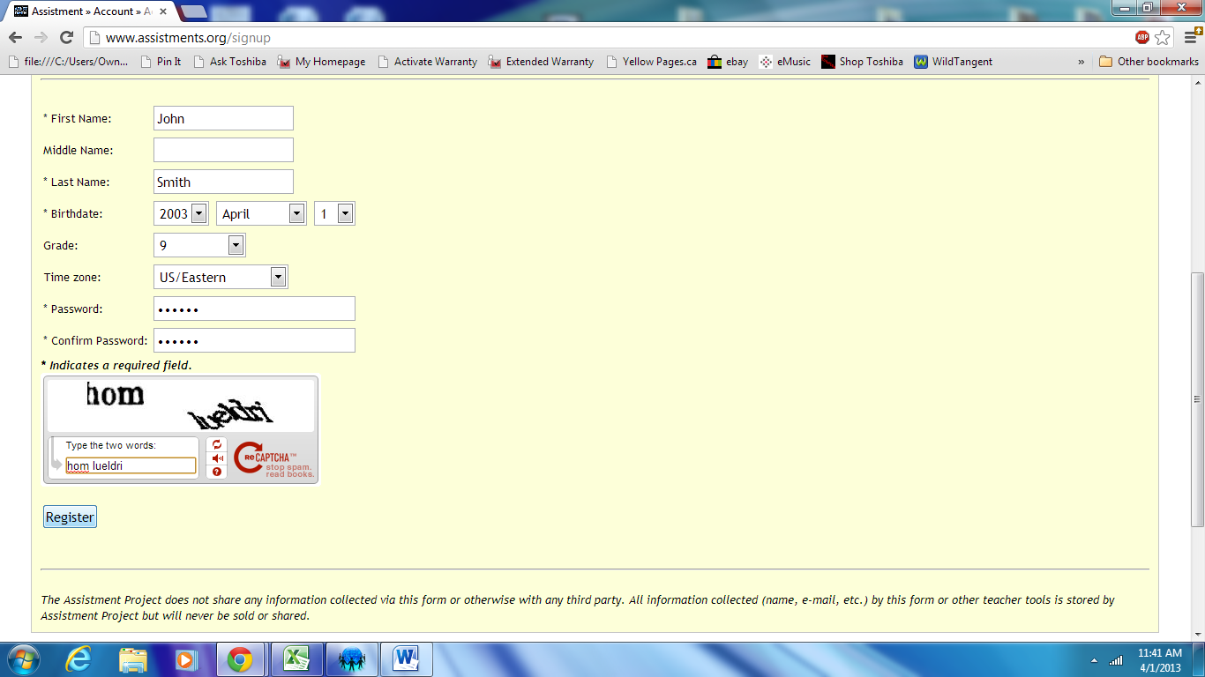
1. Enter your First Name, Last Name, Birthdate, Grade (9), and Time Zone (US/Eastern)
2. Enter a password of your choice
3. Fill out the Captcha, click Register

Slide 8
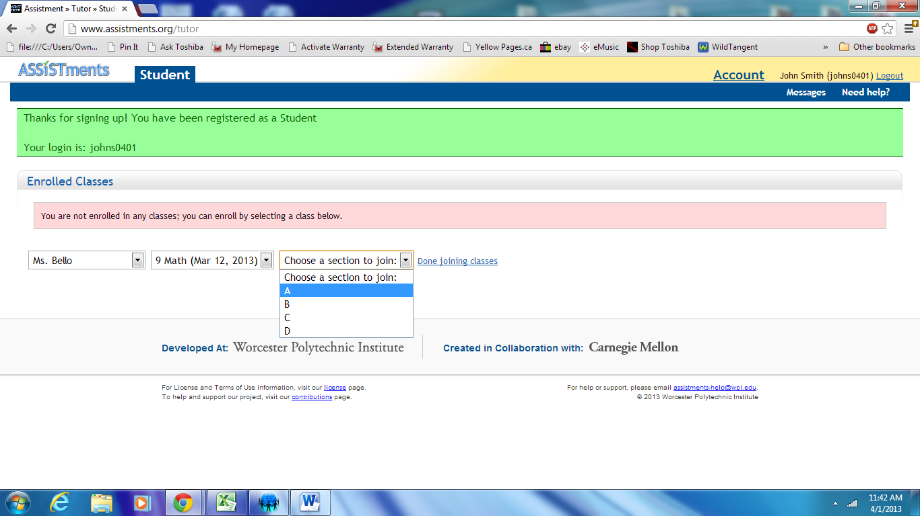
1. Choose your teacher: Ms. Bello
2. Choose your course: 9 Math
3. Choose a section to join: A, B, C, or D (pick the right one!)

Slide 9
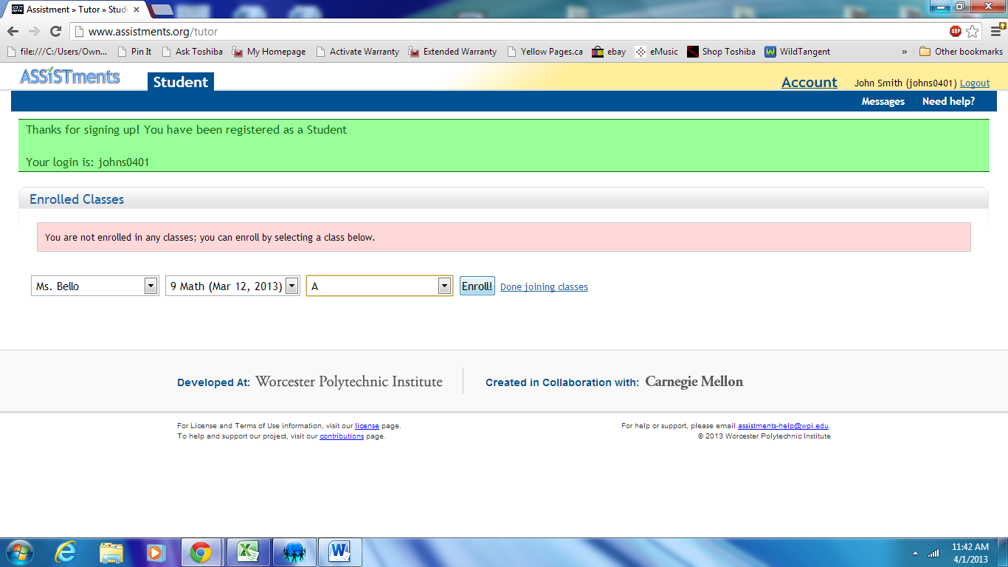
1. Click Enroll!

Slide 10
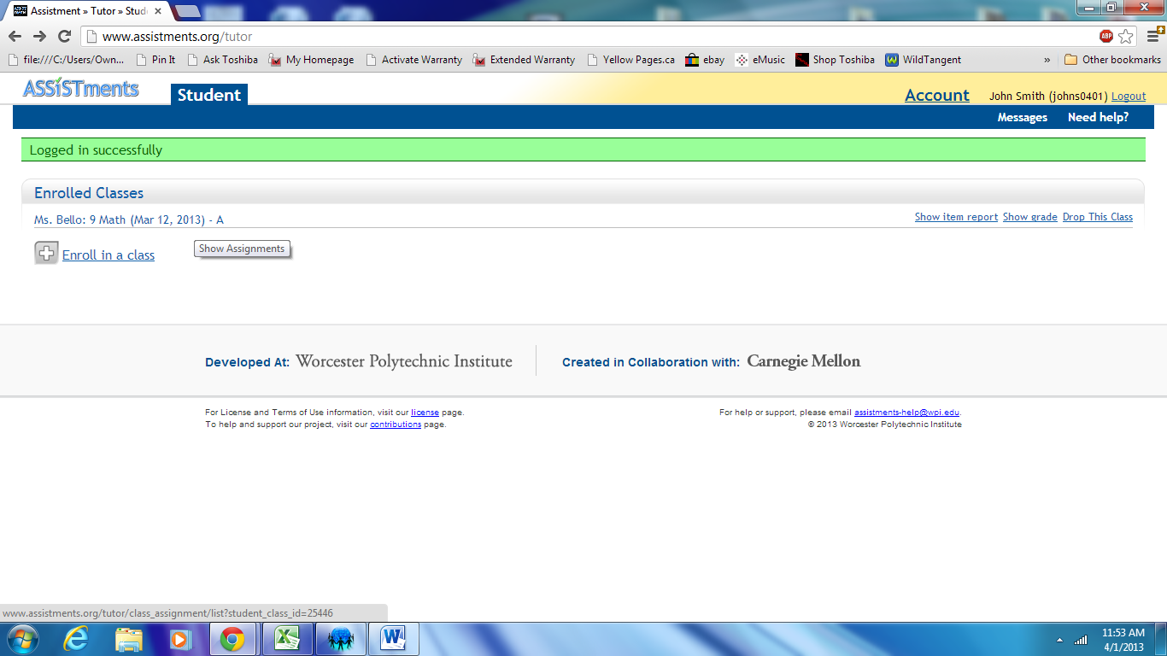
1. Click Ms. Bello: 9 Math (Mar 12 2012)
* This will show you all the available assistments

Slide 11
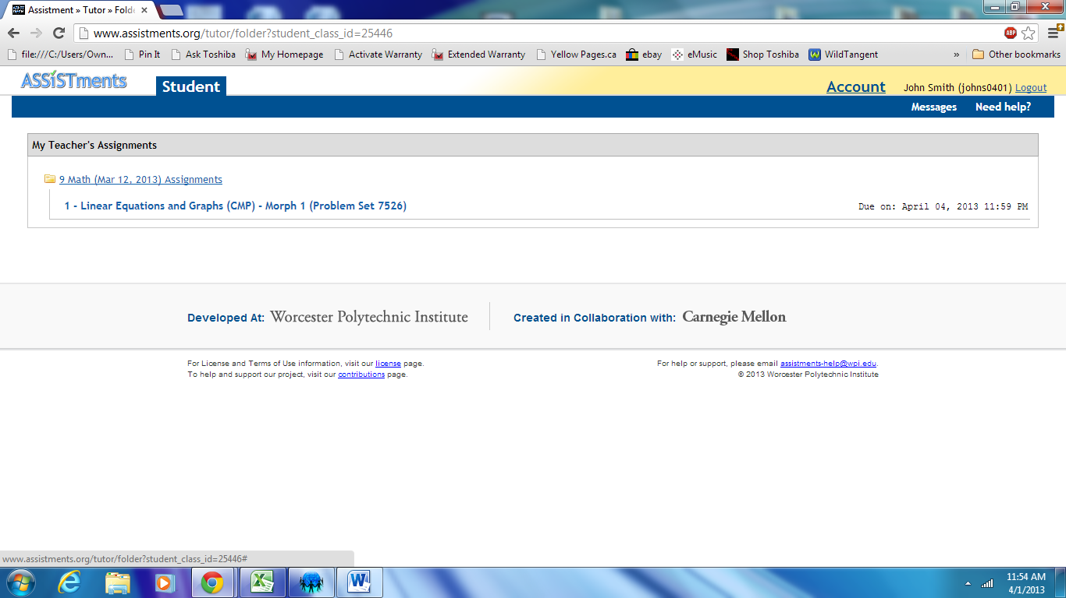
1. Your first assistment is Linear Equations and Graphs (7526).
*Please note the due date (April 4th). Click on the title to begin the assistment.

Slide 12
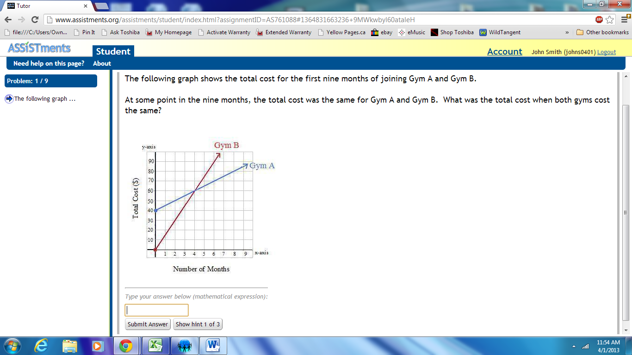
1. Here’s what the first question will look like. Enter your solution in the box at the bottom of the page, and select Submit Answer.
2. If you’re stuck, you can click Show hint

Slide 13
If you have any difficulty setting up your account, please email me to let me know, so I can remedy the situation BEFORE you come to class on Friday.

