Slide 1
Distance – Time Graphs
A distance - time graph compares the distance that someone or something travels, compared to time.
Time is the independent variable.
Distance is the dependent variable.
Important note: For clarity, we’ll call the origin “home”, but it could just as well be some other location, or just an arbitrary point.

Slide 2
Important Vocab
Speed – distance/time
“I am going 80 km per hour”
Velocity – distance/time, with a direction
“I am going 80 km per hour north”
Acceleration – increasing your speed
Deceleration – decreasing your speed

Slide 3
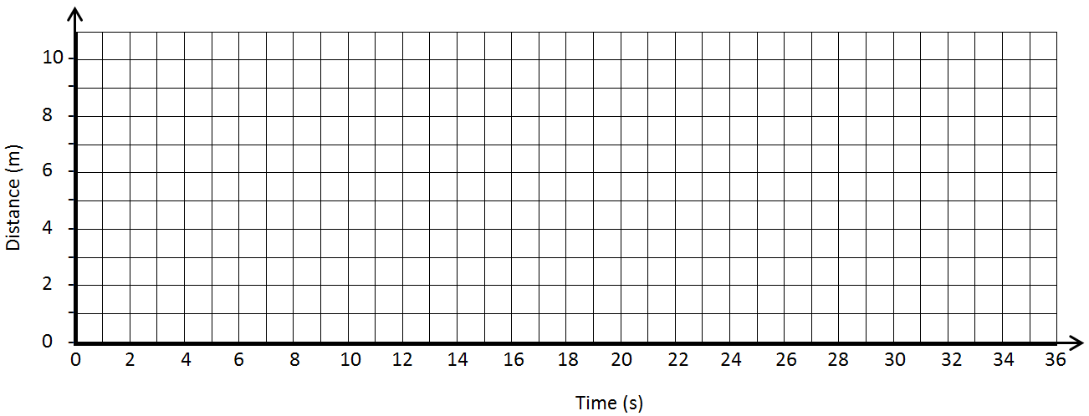
1. What does the graph look like if…
…the person is standing still?

Slide 4
2. What does the graph look like if…
…the person is moving away from home at a constant velocity?

Slide 5
3. What does the graph look like if…
…the person is moving away from home FASTER at a constant velocity?

Slide 6
4. What does the graph look like if…
…the person is moving TOWARDS home at a constant velocity?

Slide 7
5. What does the graph look like if…
…the person is accelerating away from home?

Slide 8
6. What does the graph look like if…
…the person is decelerating away from home?

Slide 9
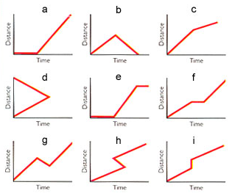
7. Describe what is happening for each graph (some are impossible!)

Slide 10
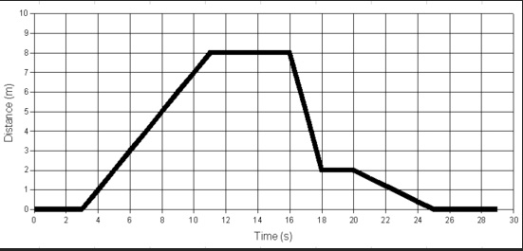
8. Create a story that could describe the motion depicted on this graph
Your story:
When is the person stopped?
When does the person begin returning to their starting point?
When are they travelling the fastest?

Slide 11
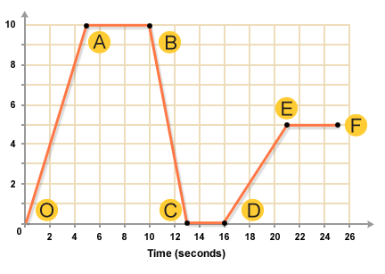
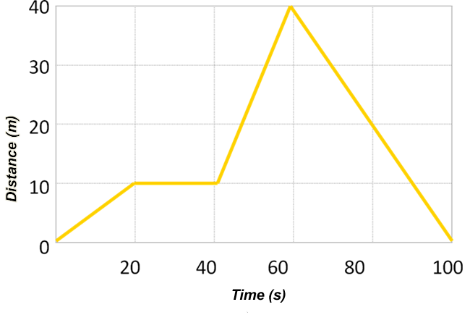
Create a story that could describe the motion depicted on each graph
Distance (m)
9. 10.

Slide 12
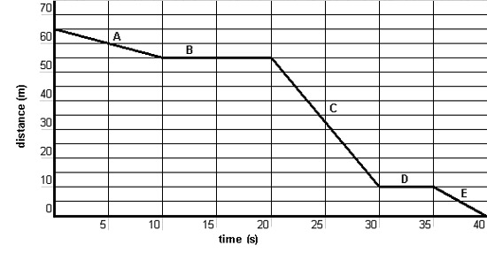
Create a story that could describe the motion depicted on each graph
11. 12.

Slide 13
Create a graph to match each situation
Bianca slowly walks to school. She stays at school for a while and then she walks home at a faster speed.
John leaves his house to walk to school at a constant pace. On the way there, he stops for a bit at a red light. He then continues at a faster pace than before. He stays at school for a little while, then he returns home.

Slide 14
Create a graph to match each situation
Tiziano goes to school at a constant pace, and then immediately returns home at the exact same pace.
Chris walks home from school. He is decelerating along the way.

